Slide 1

Who Spoke When?
Catherine Breslin
Research Scientist
Amazon, Cambridge UK
twitter: @catherinebuk
Disclaimer: this presentation discusses existing work and does not reflect Amazon’s interest or views on the subject

Slide 2

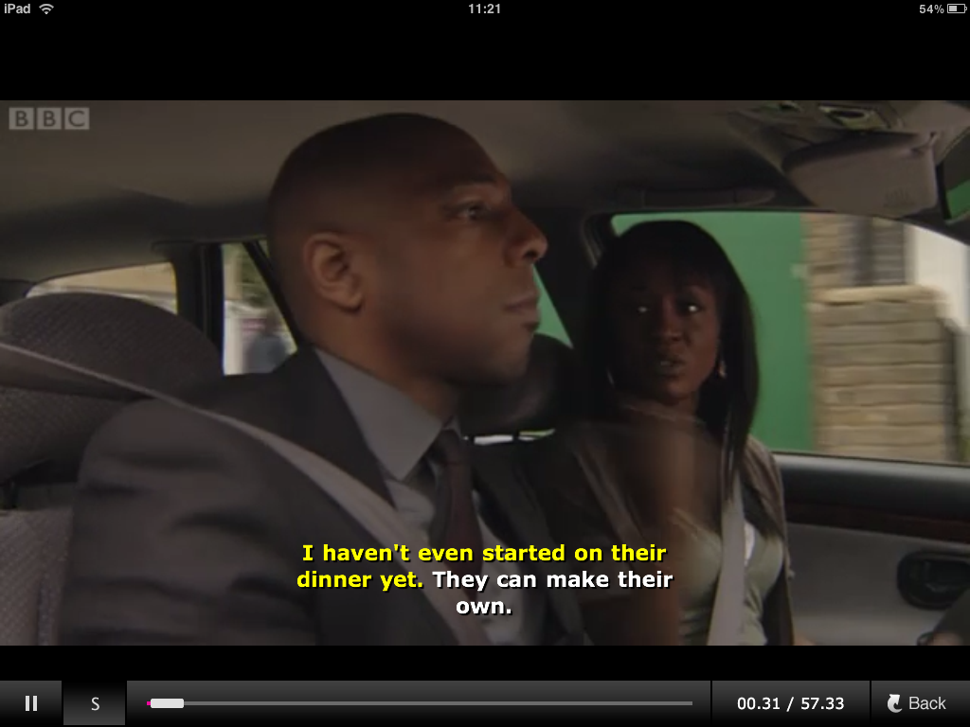

Who spoke when?

Slide 3

Pipeline
Feature
extraction
Segmentation
Clustering
Who spoke
when?

Slide 4
Pipeline
Feature
extraction

Slide 5
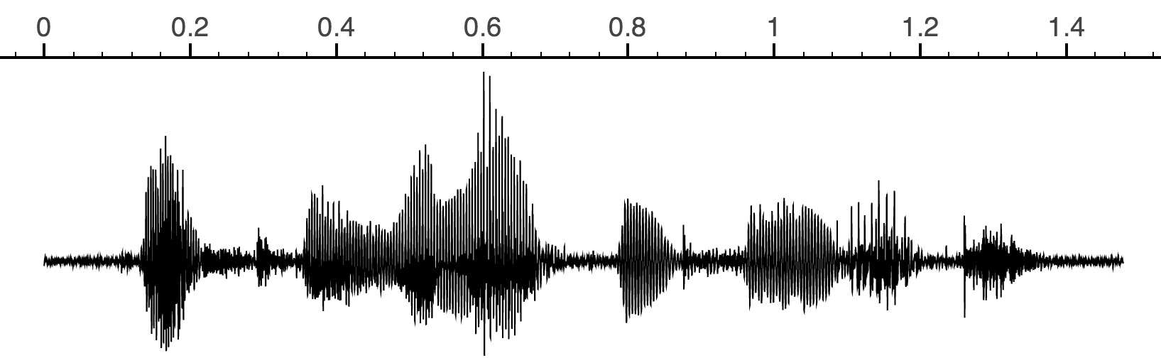

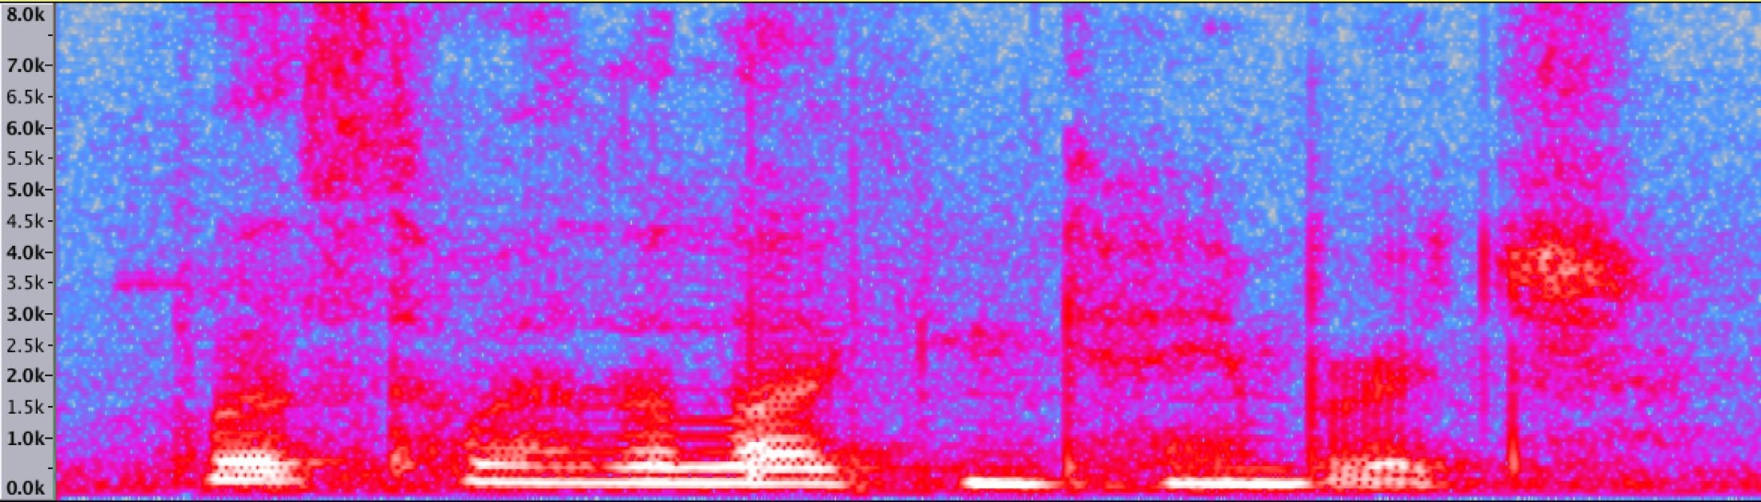
Waveforms and spectrograms
What’s the weather like in Cambridge?

Slide 6
Waveforms and spectrograms
What’s the weather like in Cambridge?

Slide 7
Speech characteristics
What’s the weather like in Cambridge?
pitch
harmonics
(formants)
‘silence’
‘noise’

Slide 8
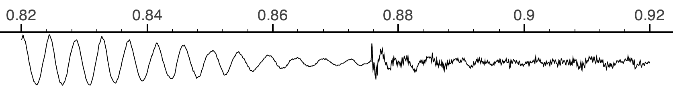
Feature extraction
25ms overlapping frames with 10ms frameshift
Feature vectors
…
1.1
0.3
…
0.1
1.2
1.1
…
0.5
1.7
0.6
…
1.0
…

Slide 9
Pipeline
Feature
extraction
Segmentation

Slide 10
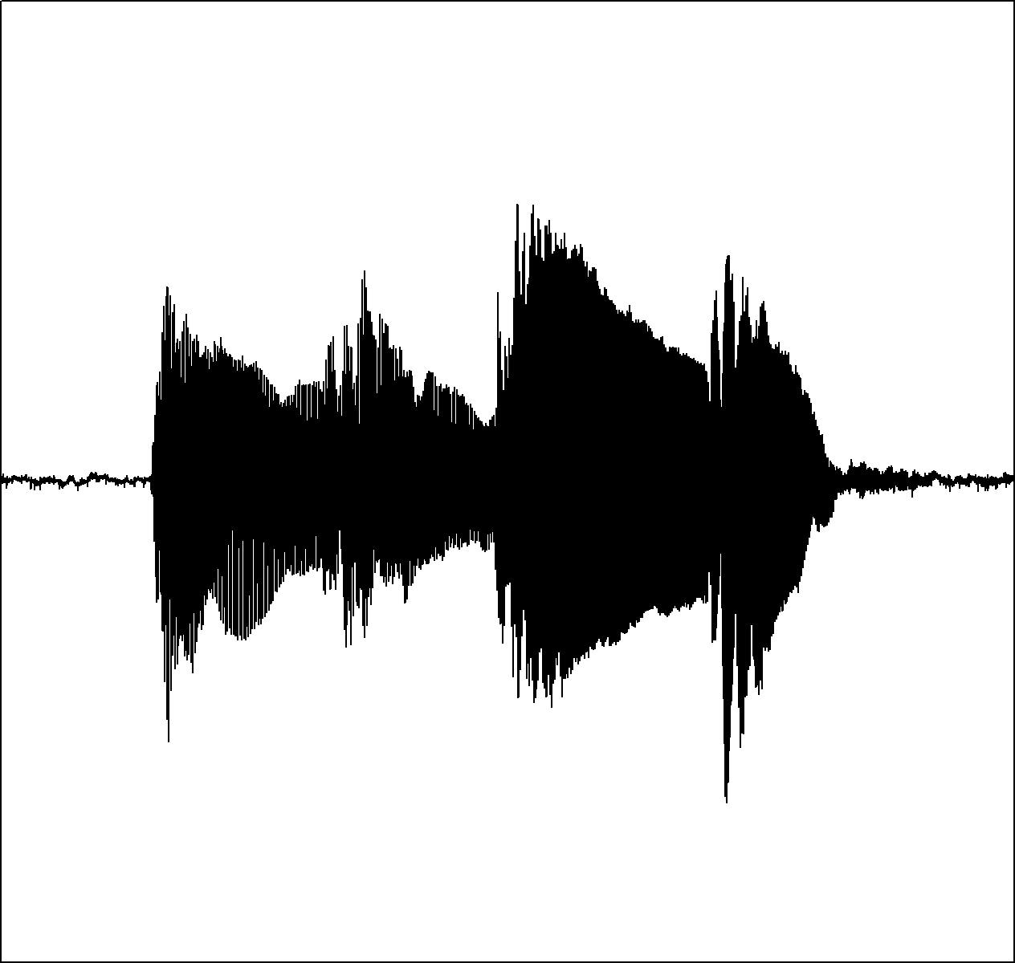
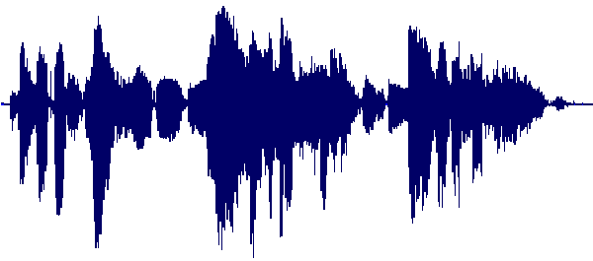
Segmentation
Where is the boundary
between two speakers?
* Assume we can find silences ok

Slide 11
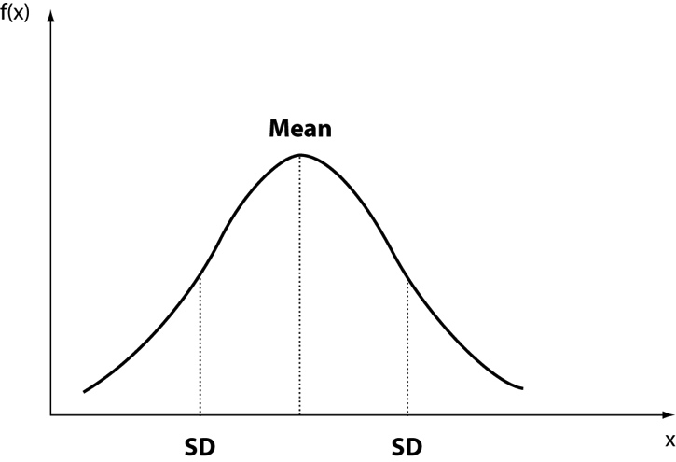
Gaussian distribution
1.1
0.3
…
0.1
1.2
1.1
…
0.5
1.7
0.6
…
1.0
…
d
N
Model frames as if Gaussian distributed
Compute mean and standard deviation of
our feature vectors
Accumulate x(t) and x(t)²
O(dN) to compute for a segment of length N

Slide 12
Bayesian Information Criterion (BIC)
Window that could be modeled by one Gaussian or two.
BIC = likelihood difference – penalty

Slide 13
BIC for Segmentation
max
BIC
Time

Slide 14
BIC for Segmentation
# Get feature vectors from audio
for i=1:T
compute feature(i)
# BIC sliding window
for i=1:T
Create window centered on time i
Compute Gaussian (μ,Σ) for whole window
Compute Gaussian (μ₁,Σ₁) for 1st half of window
Compute Gaussian (μ₂,Σ₂) for 2nd half of window
BIC(i) = likelihood difference - penalty
# Find the speaker change points
find maxima in BIC(1:T)
O(TNd)
T = time frames
N = window size
d = Gaussian dimension

Slide 15
Points to note
Window size must be chosen
Too small and Gaussians aren’t reliable
Too big and we miss small segments of speech

Slide 16
Pipeline
Feature
extraction
Segmentation
Clustering

Slide 17

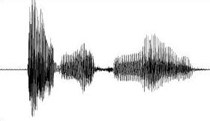
Clustering
From S audio segments:

Slide 18
Clustering
Identify K speakers:

Slide 19
Bayesian Information Criterion (BIC)
These two segments could be modeled by one Gaussian or two.
BIC = likelihood difference – penalty

Slide 20
Bottom-up clustering

Slide 21
Bottom-up clustering
Assign each audio segment to its own cluster

Slide 22
Bottom-up clustering
Iteratively merge ‘closest’ clusters

Slide 23
Bottom-up clustering

Slide 24
Bottom-up clustering

Slide 25
Bottom-up clustering
After S-K steps, stopping criterion is met
There are K clusters remaining, K<<S

Slide 26
BIC for Clustering
# Begin with one cluster per segment
Initialise one cluster C₁…C_{S} per segment
Compute matrix BIC(C_{i}, C_{j})
# Iteratively merge clusters
while (bic_change > threshold):
C_{a}, C_{b} = argmin(BIC(C_{i}, C_{j}))
bic_change = BIC(C_{a}, C_{b})
merge(C_{a}, C_{b})
update BIC(C_{a,b}, :)
update BIC(:, C_{a,b})
S = #segments
d = vector dimensionality
T = #time-frames
Naïve min(): O(S²)
Using min-heap: O(S log S)
i.e.
overall O(S² log S)

Slide 27
Points to note
Clustering unreliable for short segments
Can exclude these and have 2nd pass
Number of segments S depends on
Result of segmentation step
Audio contents

Slide 28
Pipeline
Feature
extraction
Segmentation
Clustering
Who spoke
when?

Slide 29
Things I didn’t mention
We don’t necessarily know who spoke
Can label speaker clusters e.g. A, B, C, D…
Often sufficient for further processing
E.g. speaker adaptation
Summarization
Subtitling
Online vs. offline
Single microphone vs. array

Slide 30
Further reading
“An overview of automatic speaker diarization systems”
S. Tranter and D. Reynolds
IEEE Trans ASLP
Vol. 4 p1557-1565, 2006
“Speaker diarization: a review of recent research”
X. Anguera et al
IEEE Trans ASLP
Vol. 20 p365-370, 2012

Slide 31
Who Spoke When?
Catherine Breslin
Research Scientist
Amazon, Cambridge UK
twitter: @catherinebuk
Disclaimer: this presentation discusses existing work and does not reflect Amazon’s view on the subject

